Slide 1
SOLAR PHOTOVOLTAIC ENERGY
Photovoltaic (PV) is the technology that converts sunlight (photons) directly into electricity.

Slide 2
It was first
observed in 1839 by the French scientist Becquerel who detected that when light was directed onto one side of a simple battery cell, the current generated could be increased.
In the late 1950s, the space programme provided the impetus for the development of crystalline silicon solar cells; the first commercial production of PV modules for terrestrial applications began in 1953 with the introduction of automated PV production plants.

Slide 3
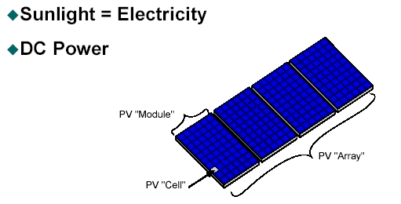

Slide 4
PV technology
No fuel required
High reliability
No moving parts
High service life
- About 30 years
5. NO
- Emission
-Pollution
-Noise

Slide 5
Features of PV
Renewable
Sustainable
Reliable
Wide application
Large potential
Flexible technology

Slide 7
Characteristics of Solar Cells
The power of solar cells depends on various factors:
Voltage (V)
Current (A)
Solar Radiation (W/ m2)
Area (m2)
Temperature of cells (°C)

Slide 8
The voltage is relatively independent of solar radiation and the area of solar cells: They are mostly based on chemical structure of a solar cells within 0.5 V and 0.6 V.
The current increases in directly proportional to the solar radiation and also to the area.
Rising temperature leads to decreasing power (around – 0.3%/K)

Slide 9
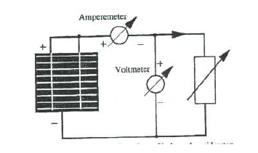

Slide 10
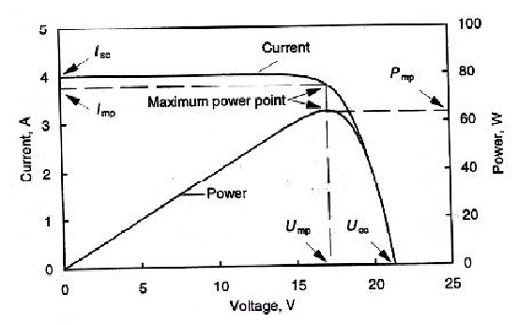
I-V and P-V characteristics

Slide 11
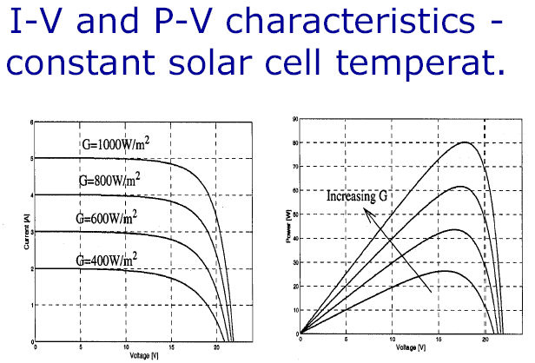

Slide 12
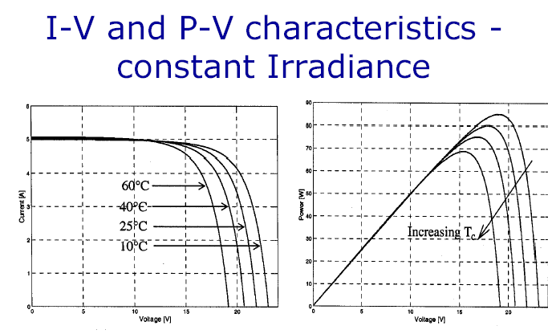

Slide 13
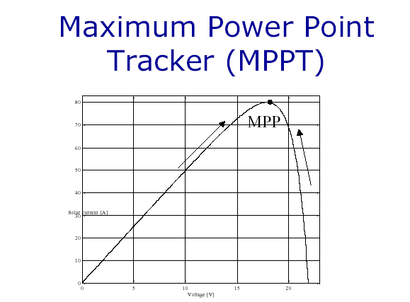

Slide 14
Series and Parallel Connection of Solar Cells and – Modules
As the light energy is bigger, also the electrical energy becomes bigger. But every solar cells can produce only 0.6 V voltage and current up to 2 A. Higher voltage and current can be produced through parallel and series connection so that many solar cells can be connected together in a solar module (solar panel) and many modules in a solar generator.

Slide 15
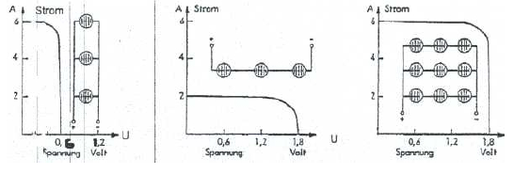
Series and parallel connection

Slide 16
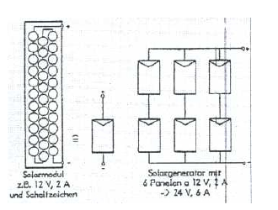
Connection of solar cells in a module (left) and from modules to a solar generator (right)

Slide 17
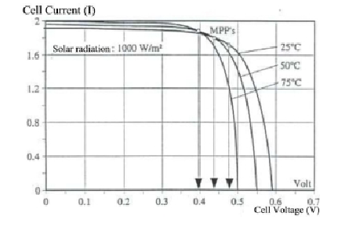
Temperature-Power relationship
The voltage to around – 0.4%/K
The short-circuit current to around – 0.06%/K
The power to around – 0.5%/K

Slide 18
Module Efficiency
One common measures of the quality of a solar cell or module is the efficiency. But there is not just one way to define “ Efficiency” for solar devices. This should be made clear, because statements are often made comparing manufacture’s efficiencies, and it can be deceiving if not clearly understood what exactly “efficiency” is being quoted…….

Slide 19
In general efficiency of is defined as the ratio of output from a device compared to the input to the device.
Efficiency = Output/Input

Slide 20
Aperture or Active Area Efficiency
This definition involves the ratio of maximum electrical power output from a solar device(cell, module, or array) compared to the light power incident on only the area of the device that is exposed or “ active” semiconductor. Light incident on shaded areas like interconnection wires, gridlines, and frame area is not included.

Slide 21
Active area efficiency is often quoted for research devices where fundamental physics is being exposed, and usually refers to a single cell. It is typically higher than the final total area efficiency will be for a device with interconnected cells.

Slide 22
Active area efficiency
Active Area Efficiency =
P max /{Active area only × Input light power}

Slide 23
Total Area Efficiency
This definition involves the ratio of maximum electrical power output compared to the total light power incident on the entire device.
The device includes frames, interconnects and pattern lines on the surface of the cells.
This is the real world efficiency of a device
Total area efficiency =
P max /{Total Device Area × Input Light Power}

Slide 24
Calculate the total area efficiency of the M55 module
Read from the module literature to find the power and area:
P max = 53 watts Length = 1.293 m
Width = 0.330 m
Total Area efficiency =
53 watts/ { 1.293 m * 0.33 m *1000 w/m2}
= 0.124
= 12.4%

Slide 25
Relation – Short Circuit Current and Light Intensity
An M55 module has a rated Isc of 3.4 amps at 1000 w/m2. We can calculate the Isc at another light level by taking the proportion of the new light level to the standard level of 1000. If the actual light intensity on a module were 850 w/m2, then the actual Isc would be given by the proportion
Isc1/Light intensity1 = Isc2 / Light intensity2
3.4 / 1000 = Isc2 / 850
Isc2 = 3.4 × ( 850/1000 )
= 2.9 amps

Slide 26
Effect of Temperature
Effect of Cell Temperature on Voc
“- 0.0024 V / deg.C /series cell ”
or “– 0.37%/deg.C ”
Effect of Cell Temperature on I sc
“+ 0.000007 Amps/cm2/deg.C ”
or “+ 0.01% / deg.C ”
Voltage Change = Voltage Loss Factor * Temperature Change * Series Cells
&
Voltage2 = Voltage 1 – Voltage Change

Slide 27
Effect of Temperature
Example
The M55 module has 36 cells in series for a Vmp of 17.3 volts at 25 deg.C . In real world conditions, the cells will easily heat up to 50 deg.C . Find out the voltage in 50 deg.C.
Solution
Voltage Change = Factor * Temp.Change * Series Cells
= - 0.0023 V/deg.C/cell * 25 deg.C * 36 cells
= - 2.1 volts
Voltage2 = 17.3 volts Vmp ( at 25 deg.C ) – 2.1 volts
= 15.2 volts Vmp ( at 50 deg.C )
Note: Which is still enough to fully charge a typical “ 12 V ” battery that actually needs up to 15 volts to reach full charge.

Slide 28
Power reduction due to rise in Temperature
Overall Reduction in Maximum Power
= – 0.45 % / deg.C
% Power Change = Power Reduction Factor * Temperature Change

Slide 29
Power reduction due to rise in Temperature
Example
An M55 module is rated at 53 watts P max at 25 deg.C . If it is operating outdoors and heats up to 50 deg.C, then the P max will be reduced
% Power Change = - 0.45 % ( 50 – 25 )
= - 11.25% Change
Pmax2 = Pmax1 {1 - % Power Change/ 100}
= 53 watts P max @ 25 deg.C*{1-11.25/100}
= 47 Watts P max @ 25 deg.C

Slide 30
Efficiency of Solar Cells
Type Efficiency in Lab Efficiency in Field
Mono crystalline 24 14-17
Polycrystalline 18 13-15
Amorphous 13 5-7

Slide 31
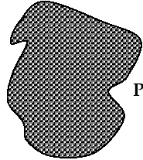
Mono crystalline
are made of silicon wavers cut from one homogenous crystal in which all silicon atoms are arranged in the same direction

Slide 32
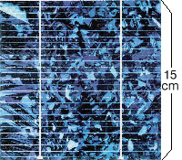
Polycrystalline
Are poured and cheaper and simpler to make than monocrystalline silicon.
Due to different crystals give the material its characteristic flaky blue metallic color.
The efficiency of multicrystalline cells is however somewhat less than that of monocrystalline

Slide 33
Amorphous cell
Are made with help of a deposition technique, like plasma deposition. silicon Cells,
They are relatively cheap, but with low efficiency.
AMORPHOUS" means: No crystalline structure

Slide 34
Module Manufacturing
The manufacturing process can be presented as three segments or phases:
Crystal and wafer fabrication
Cell manufacturing
Module assembly

Slide 35
Wafer Manufacturing
The process of making a solar module ultimately begins from mining of raw material. This usually consists of high quality silica or quartz(SiO2)from mines. In large furnaces, the silica is reduced to silicon (Si) and then purified until it becomes 99.9999% pure!

Slide 36
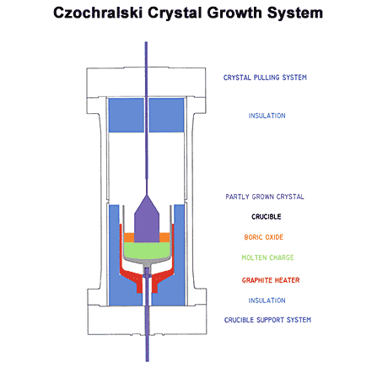
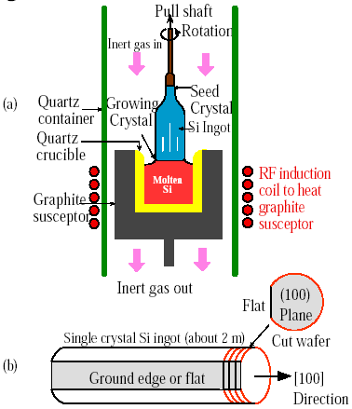

Slide 37
Wafer Manufacturing Steps
Begin with 99.999% pure polysilicon
Melt with boron to make P-type silicon
Grow single crystal ingot
Saw into square ingot
Slice into wafers
Etch in NaOH to remove damage and create “pyramids”

Slide 38
Wafer Manufacturing…
Chunks of purified silicon are carefully loaded into a crystal growing furnace, along with a small amount of the element boron. The furnace is sealed and the chunks are heated until they melt 1440 deg.C. A small “seed” crystal of pure silicon about the size of a pencil is lowered inside the furnace until it touches the liquid.

Slide 39
Wafer Manufacturing…
The cooler seed acts as a template and atoms of silicon and boron freeze onto it, and the free seed begins to grow. By carefully controlling temperatures and the speed of growth, the diameter of the growing crystal is increased to about 5’’ and then held steady by computerized controls.The growing crystal or ingot now grows in length until it is about 30-40’’ long.

Slide 40
Manufacturing Flow
Charge sand (quartz) into silicon
Diffuse with Phosphorus
Solder Cells together
Plasma etch Edges
Melt and grow
Into single crystal
Laminates
Coat with anti-reflective coating
Attach Frame, j-box, diodes
Crop,slab and saw into wafers
Print Contacts
Final Electrical Test
Etch Surface
Electrical Test

Slide 41
Wafer Manufacturing…
The process of growing a single crystal structure from a small seed crystal is called
The Czochralski Method
Usually abbreviated as just CZ

Slide 42
Wafer Manufacturing…
After removal from the crystal growing furnace, the ingot ends are cropped off and recycled. The ingot is cut along its lengths to make a square block. The square cells cut from this block will pack together very closely and result in high module area efficiency.
The block is mounted onto a crystal cutting saw which will slice thin wafers.The blade of the saw spins very quickly(approximately 1600 RPM) and has its cutting edge on the inside.This cutting edge is made of diamond dust,necessary to cut the hard brittle silicon.The wager are only 0.015’’ thick and are sliced one after the other.

Slide 43
Wafer Manufacturing…
The wafers are then etched to remove some surface damage caused by the saw blade abrasion, and to create a surface that helps absorb light. The final wafer surface is made of millions of tiny 4-side pyramids, following the pure crystal structure in the original seed.

Slide 44
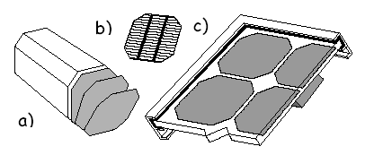
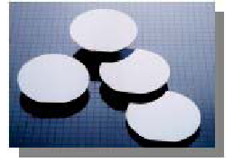
Slicing

Slide 45
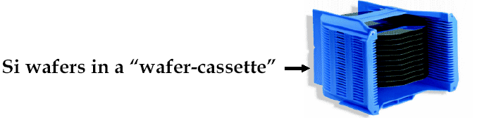

Slide 46
Cell Manufacturing
Steps
Diffuse with phosphorous to make N-type layer
Remove edge layer
Deposit anti-reflective coating of TiO
Print silver grid patterns on front and back
Electrically test

Slide 47
Wafers are next loaded into diffusion tubes which are long tubes of silica glass, surrounded by large resistive heaters, and that will contain a hot gas of phosphorous. A computer controls the entire process, slowly moving wafers into the chamber, allowing gases to flow for precise amounts of time, and then removing the wafers.
Inside the tube, the atoms of phosphorous penetrate or “diffuse” into the wafer a short distance, only 12 millionths of an inch or 0.3 micorns, and embed themselves in the crystal structure. This embedding of select impurities into a semiconductor like silicon in called “doping”

Slide 48
The differences between phosphorous doped silicon and the base material of boron doped silicon set up a permanent electric field in each wafer. This field sweeps out electrons that are knocked loose by light, and makes the wafer into an active “Solar Cell” when light shines on it.
The cells are loaded onto a series of automated high speed screen-printers that print a pattern of metal paste onto the front and back. The pattern of lines and contact pads is designed to efficiency collect electrons that reach the cell surface, without blocking out too much sunlight.

Slide 49
Module Manufacturing
Steps
Connect cells in series with dual ribbons of tin-coated copper
Laminate
-Glass
-EVA( Ethylene Vinyl Acetate )
-Cell Circuit
3. Attach aluminum frame
4. Install junction boxes
5. Electrically test and visually inspect 100%

Slide 50
Cells are connected together in series to add voltage. This is done by an automated soldering machine that connects the back of one cell to the front of the next with two ribbons of tin-coated copper ribbon. The cells are soldered to the ribbons at multiple points to allow for expansion and contraction of the copper against the silicon . Two ribbons are used to add reliability to this critical interconnection.

Slide 51
Module Test
Visual Inspection
Performance at STC
Insulation
Measurement of Temperature
Measurement of NOCT
Performance at NOCT
Performance at Low Irradiance

Slide 52
Outdoor Exposure
Hot Spot Endurance
UV Exposure
Thermal Cycling
Humidity Freeze
Damp Heat
Robustness of Terminals
Twist
Mechanical Load
Hail Resistance

Slide 53
Cell Operating Temperature
It is important to compare the performance of modules at different temperature rather than comparing the performance of different modules at the same temperature. If a standard set of operating conditions
( insulation level, wind velocity and direction, ambient temperature, electrical loading of cells) is defined.

Slide 54
It is possible to associate a particular temperature, normal operating cell temperature (NOCT) , with each module type.
In field conditions,
Tcell (◦ C) = Tambient (◦ C) + 0.3 × Intensity (mW/cm2)
Note: This is only when modules are mounted on an open frame,when roof mounted, cell temperatures would tend to be higher.

Slide 55
Module Durability
The types of modules degradation that have been observed in the field are:
- Breakage of cells due to excessive mechanical stress caused by thermal fluctuations or by hail damage or vandalism ( Nepal telecommunication panels lost due to hail )

Slide 56
Corrosion of metallization
Discoloring of encapsulating materials
Accumulation of dirt on modules
Breakage of interconnection

Slide 57
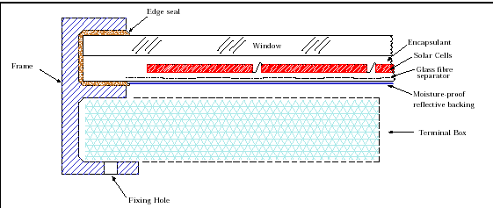

Slide 58
